Slide 1

Gan for photo animation
S8 R1
Adarsh S
Aswin Raj
Sreeram S P
Hareesh Dileep
Project Guide:- Ms Mercelin Francis

Slide 2
Overview
Introduction
Area Of This Project
Components
Problem
Solution
Hardware Required
Software Required
System Model

Slide 3
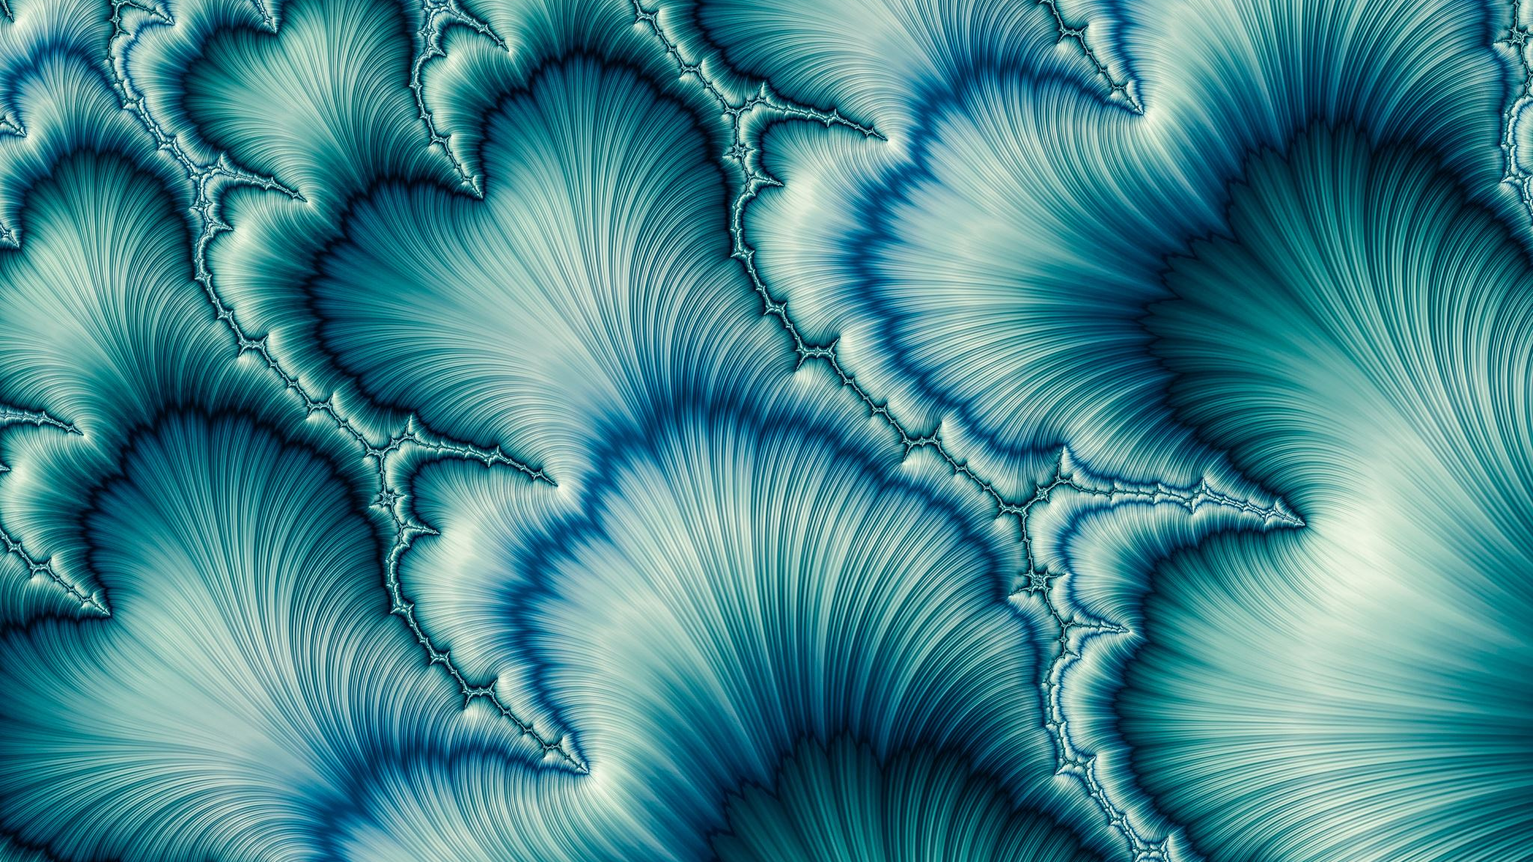
Introduction
Generative adversarial networks (GANs) are a recent innovation in machine learning. It is one of the futuristic technology in Machine Learning.

Slide 4
Area of this project
Computer Vision
Deep Learning
Machine Learning

Slide 5
components
There are 2 components in GAN
Generator
Discriminator

Slide 6
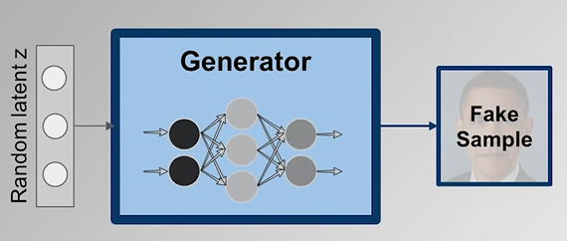
Generator

Slide 7
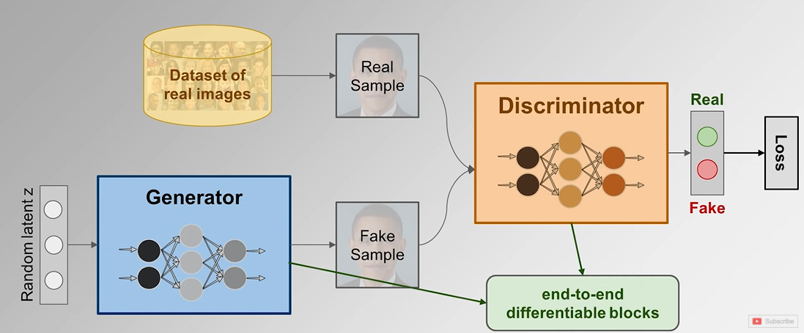
discriminator

Slide 8
GAN Objective Function
We have Generator and Discriminator and we want the Discriminator to identify the input data which are receiving from data set and Generator as real or fake.
For that we have an equation:-
We are using Mini Max concept.

Slide 9
Coming to the problem
Entertainment industry normally hire sketchers for creating new character for their project.
Each sketchers takes lot of time to create new character . They usually take 2 to 3 weeks to create new characters. Entertainment Companies needs to invest lot of money on Sketchers and Drawing Artist.
For creating new character the accuracy of each character may vary which leads to inconsistency.

Slide 10
Solution
So to solve this problem we are going to create new application using Anime GAN .
We are going to create new characters by giving some random characters as input.
We can create new characters in less span of time.
The accuracy for creating new character can be maintained throughout.

Slide 11
System required
Intel Core i7 Processor
Nvidia GeForce GTX 1650 Ti
16 GB RAM
1 TB SSD

Slide 12
Softwares and drivers required
CUDA
CuDNN
Pytorch
Pycharm
Linux System

Slide 13
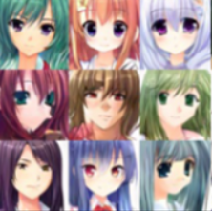
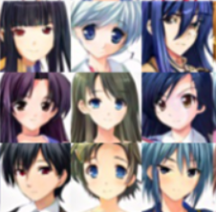
System model
Input Output

Slide 14
Thank you

